Slide 1
Computer Organization and Assembly Fall 2019
CF vs Of
Syeda Farwa Batool

Slide 2
Carry Flag and Overflow flag
The Carry flag (CF) is set when the result of an unsigned arithmetic operation is too large to fit into the destination.
The Overflow flag (OF) is set when the result of a signed arithmetic operation is too large or too small to fit into the destination. or when your carry in different from carry out.

Slide 3
Two’s Complement Ranges
Range = -2 ^{(n-1)} to + (2^{(n - 1)} -1)
Where n in number of bits to store 2’s complement signed integer
Number with value greater than +(2^{(n + 1)} -1) and number value less than
-2 ^{(n+1)} would require more bits. If you try to store too large/small value overflow flag will be set
Now for next slides our n = 16
Too large numbers can be > 32767
Too small numbers can be < -32768

Slide 4
Example 1
Too small
When a carry is not generated from your most significant bit (here 15th bit if lest significant bit is at 0) and a carry is inputted into your most significant bit
For example 1 (For this example is assumed I have both signed number to add)
Operand | Decimal | Decimal after 2’s comp Write is value in program | Hex after 2’s comp | Binary after 2’s comp
1 (signed) | -16384 | 16384 | 0x4000 | 0100000000000000
2 (signed) | -16384 | 16384 | 0x4000 | 0100000000000000
Answer OP1 + OP 2 (signed) | -32768 | 32768 | 0x8000 | 01000000000000000

Slide 5
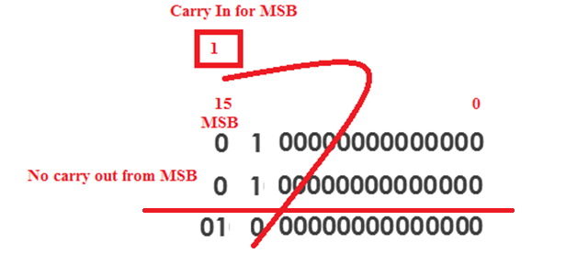
Analysis of Example 1
In example 1 both numbers are signed and their addition generates a too large number. And we have a carry out from MSB (so CF will set). But we don’t have carry in MSB so our OF will be set.

Slide 6
Example 2
Too Large
When a carry is generated from your most significant bit (here 15th bit if lest significant bit is at 0) and a carry is not inputted into your most significant bit
For example 2 (For this example is assumed I have both unsigned number to add)
Operand | Decimal | Decimal after 2’s comp | Hex after 2’s comp | Binary after 2’s comp
1 (unsigned) | 32768 | 32768 | 0x8000 | 1000000000000000
2 (unsigned) | 32768 | 32768 | 0x8000 | 1000000000000000
Answer OP1 + OP 2 (signed) | 65536 | 65536 | 0x10000 | 10000000000000000

Slide 7
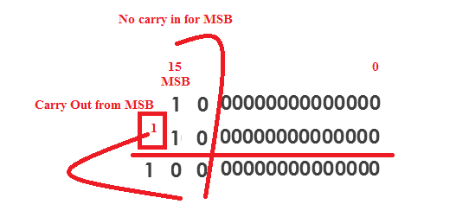
Analysis of Example 2
In example 1 both numbers are unsigned and their addition generates a too small number. And we don’t have a carry out from MSB (so CF will not set). But we have carry in MSB so our OF will be set.

Slide 8
Conclusion
In example 1 our overflow flag sets and we need that information because our both number are signed. But we do not need to see carry flag because it is signed arithmetic.
In example 2 our overflow flag sets but if doesn’t give us any information and we do not need that information because our both number are unsigned. So need to see only Cary flag
Type of arithmetic depends upon us. Its our understand that written number is positive or it’s a 2’s complement of any negative number.
But we should know when overflow flag set or when it does not set

